Slide 1
Day 3 – Multi-satellite Hotspot Composite
ASMC Workshop in Malaysia
Singapore, 23 – 25 Mar 2020
25 Mar 2020

Slide 2
Outline
Limitations with current hotspot products
Advantages of multi-satellite hotspot composite
ASMC Multi-Sat Fire Detection Product
Future Plans
Case Studies & Discussion (45 mins)
Notes:
Current hotspot products
List all the satellites
How do hotspot detections work
Pros and Cons of geostationary and polar-orbiting satellites
Current way of analyzing
Requires professional, conflicting info
Not user-friendly
Advantages of multi-sat composite
Specific needs of AMS, geared for operations
How the new product works
Methodology
Verification studies
Examples
Future plans
FY-4 satellite and GK-2A

Slide 3
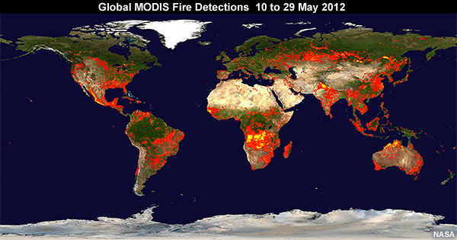
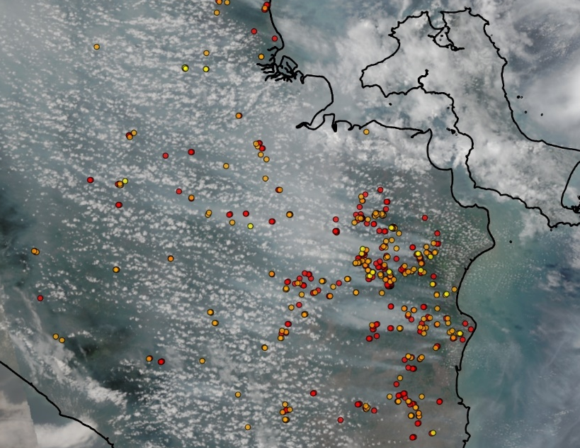
Fire Hotspot Products
Satellite fire hotspots have been widely used for vegetation fire monitoring since the 90s
Excellent spatial coverage
Good at detecting large forest and land fires under clear sky conditions
Number of satellites in-orbit capable of fire detections has been increasing over the years
Different versions of fire hotspot products developed
Fire hotspots from polar-orbiting satellites (e.g TERRA, AQUA, Suomi-NPP, NOAA-20) remained as the primary fire product used operationally worldwide
NOAA-20 Fire Hotspots

Slide 4
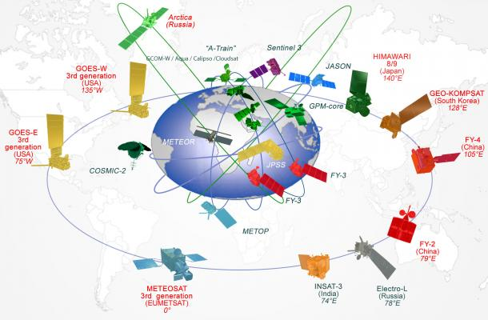
Global Space Observation Programme
Source: WMO

Slide 5
Fire Hotspot Products from Different Satellites
Satellite | Orbit | Resolution | Frequency
METOP-A/B/C | Polar | 1.1 km | Twice a day
TERRA | Polar | 1 km | Twice a day
AQUA | Polar | 1 km | Twice a day
Suomi-NPP | Polar | 0.375 – 0.75 km | Twice a day
NOAA-20 | Polar | 0.375 – 0.75 km | Twice a day
Himawari-8 | Geostationary | 2 km | 10 min
FY-4A | Geostationary | 4 km | 15 – 30 min
GK-2A | Geostationary | 2 km | 10 min

Slide 6
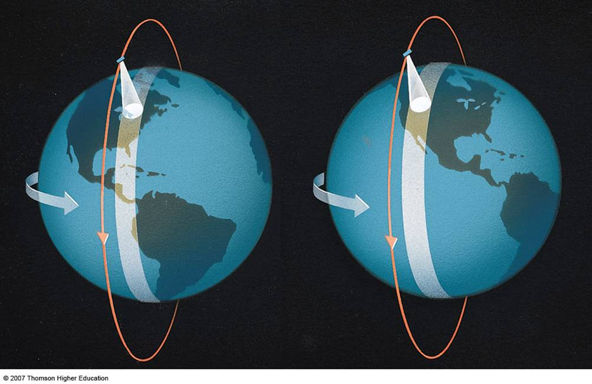
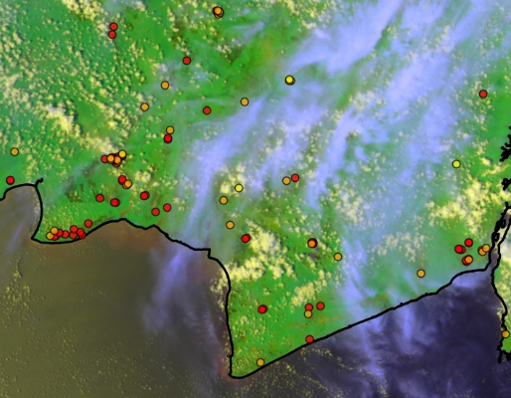
Key Limitations
Cloud cover
Fire hotspots
Lack of frequent observations
Available only twice a day
Unable to detect fires outside of observation period
Prone to cloud cover
Unable to detect fires beneath thick clouds
Particularly challenging in the tropical regions where cloud cover is common

Slide 7
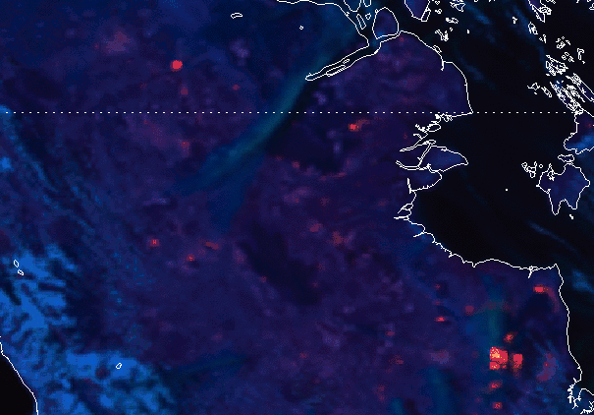
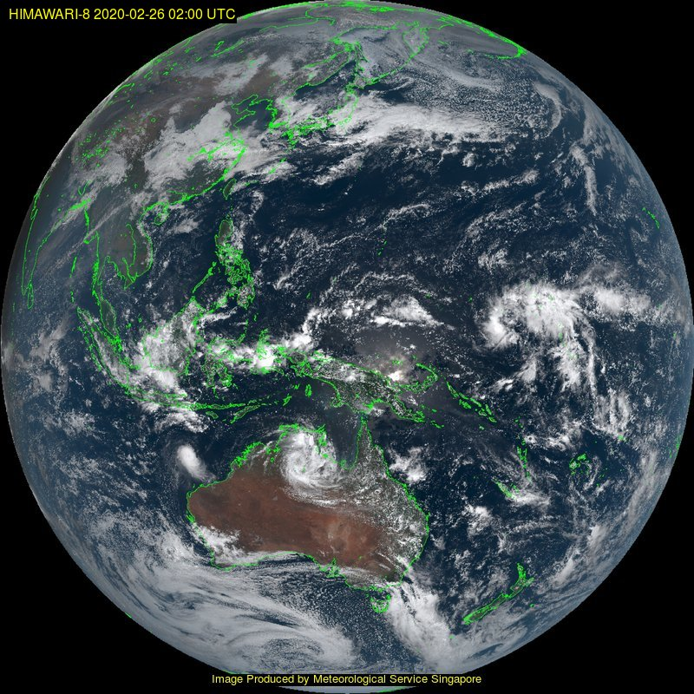
Geostationary Satellite Fire Hotspots
New generation geostationary satellites (Himawari-8, GK-2A) is capable of providing frequent observations
Advantages:
Regular and frequent observations, excellent spatial coverage
Fewer missed detections blocked by cloud cover
Disadvantages:
Lower resolution, unable to detect small fires
Product maturity level still lags behind that of polar-orbiting hotspot products, not yet suitable for public use in general
hotspot
hotspot

Slide 8
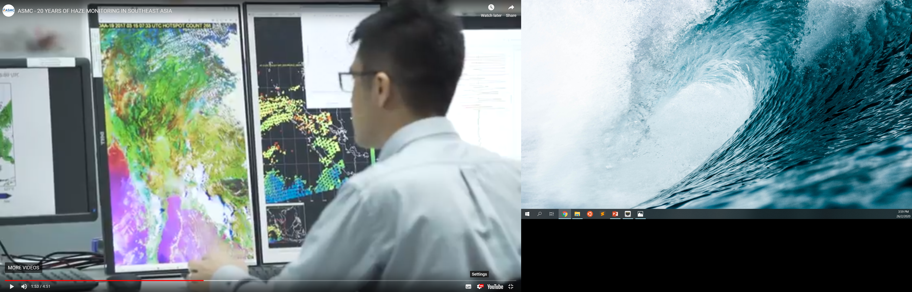
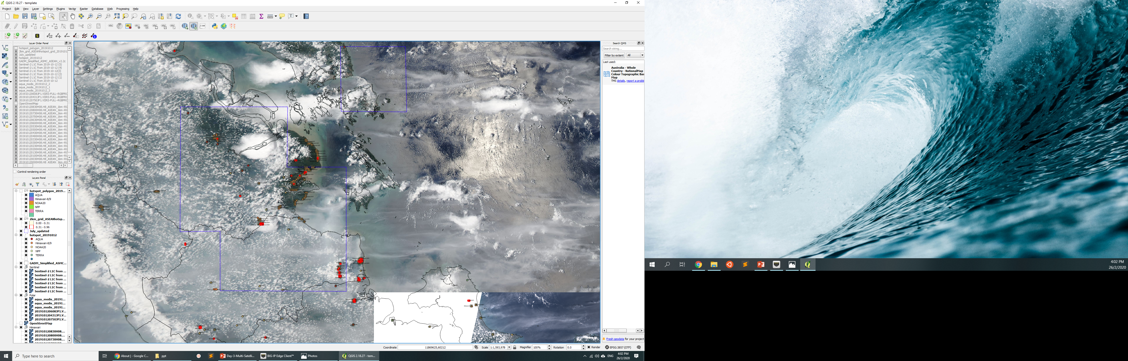
Addressing Limitations with Expert Knowledge
Manual analysis and expert knowledge in remote sensing are often required to address these limitations
Large volume of real-time imageries and hotspot data from different satellites need to be analysed together
State-of-the-art IT systems and software required
Best practice but not accessible to general users

Slide 9
Combining Fire Hotspots from Different Satellites
NOAA-20
Himawari-8
AQUA
TERRA
Suomi-NPP
Advantages:
Combine the best traits of polar-orbiting and geostationary satellite data
Higher accuracy and less prone to issues of cloud cover
All-in-one satellite hotspot product
Easy to use and no extensive manual analysis required
More accessible to general users although expert interpretation is still useful

Slide 10
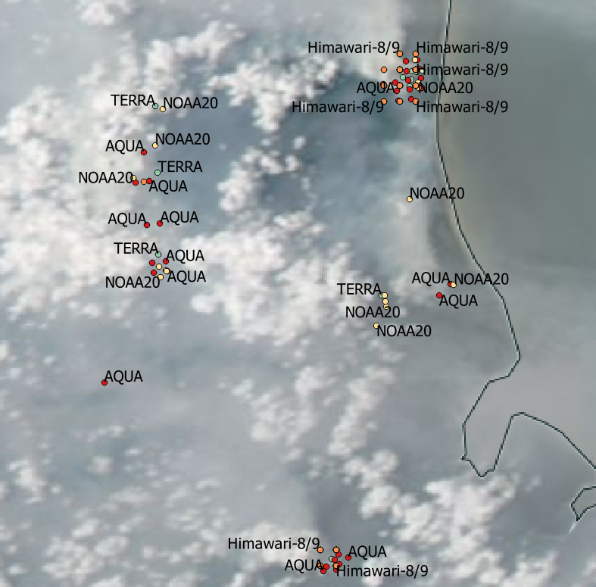
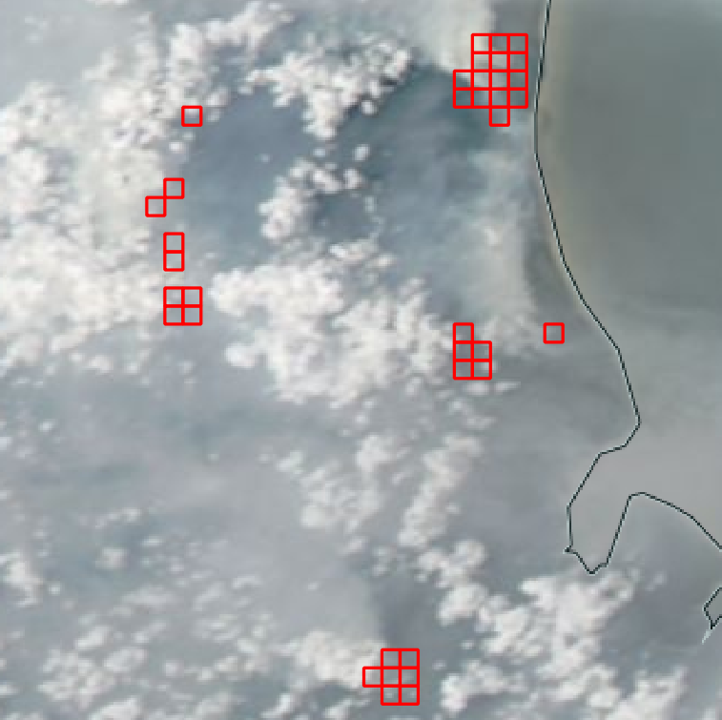
ASMC Multi-Sat Fire Detection Product
Fire hotspots from different satellites
ASMC Multi-Sat Fire Detection Product
Hotspot
Hotspot
Hotspot
Trial machine learning product developed in-house by ASMC
Fire hotspot composite based on all major fire hotspot products from different satellites
Polar-orbiting: NOAA-20, Suomi-NPP, TERRA, AQUA
Geostationary: Himawari-8

Slide 11

How it works ?
Consensus-based probabilistic estimates to determine how likely a fire hotspot is located within the area
Larger and persistent fires are more likely to be determined by multiple satellites orbiting at different time of the day
False detections are usually transient, and rarely get detected by multiple satellites simultaneously

Slide 12
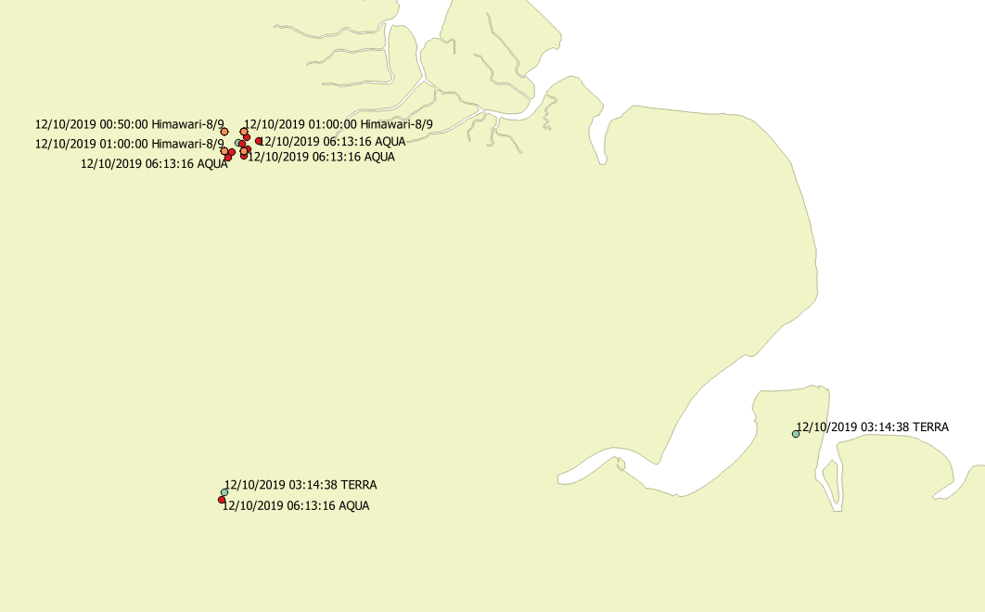
Quiz: Real fire or false detection ?
A. Large fire with smoke haze
B. Small fire with smoke plume
C. Possibly false detection or short-lived fire

Slide 13
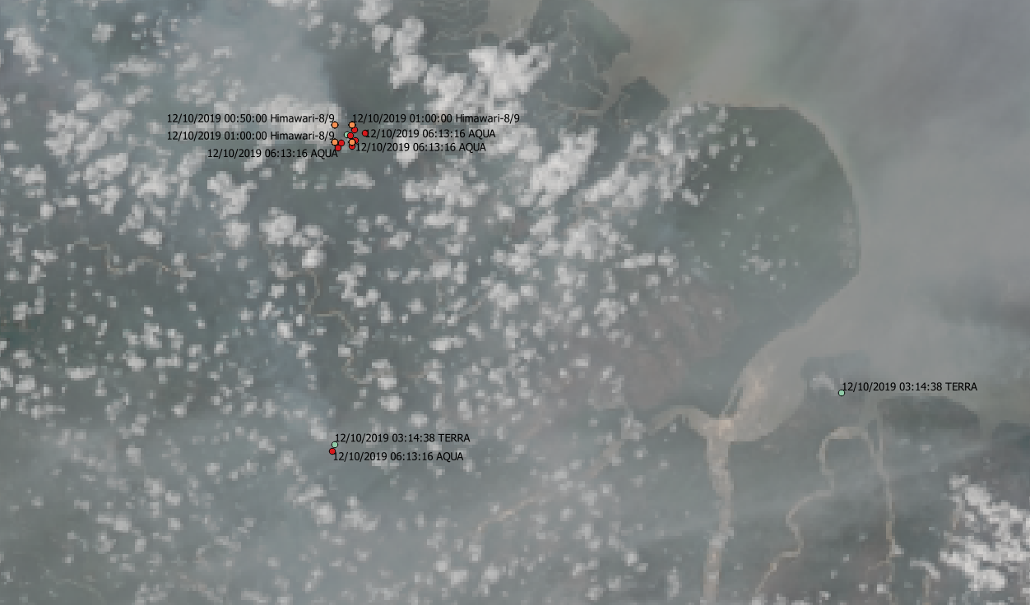
Answer: Real fire or false detection ?
A. Large fire with smoke haze
B. Small fire with smoke plume
C. Hotspot located on cleared lands (reflective surface)
A
Smoke
C
B
Sun glint
Smoke

Slide 14
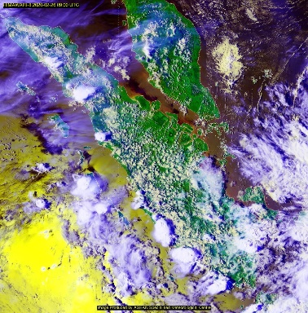
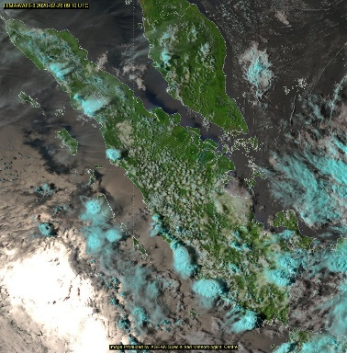
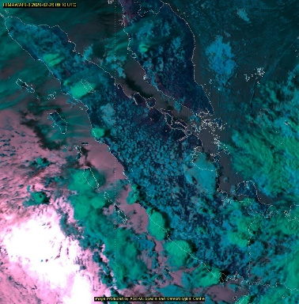
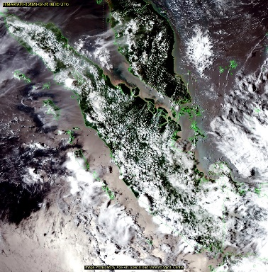
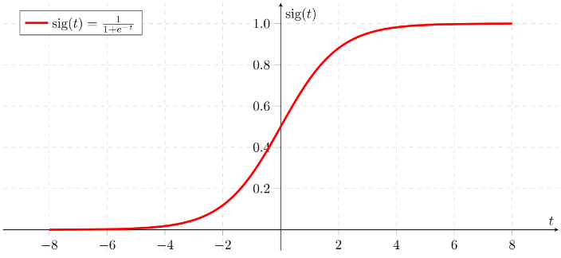
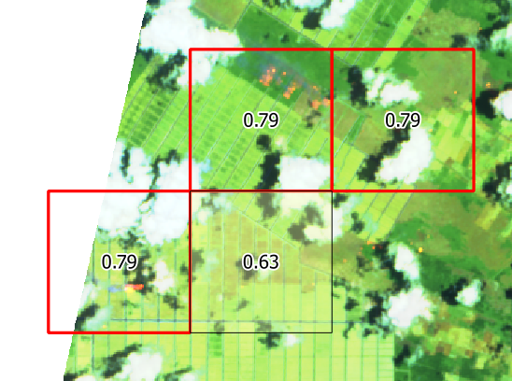
Satellite hotspot data
TERRA
AQUA
Pre-processing
Quality control
Sun glint filter
Machine Learning Model
Logistic Regression
Training & Verification
NOAA-20
Suomi-NPP
Himawari-8
Regridding
Temporal Aggregation
Model parameter optimisation
Verification against tagged data
Final Product
Probabilistic estimates for fire hotspot grid

Slide 15
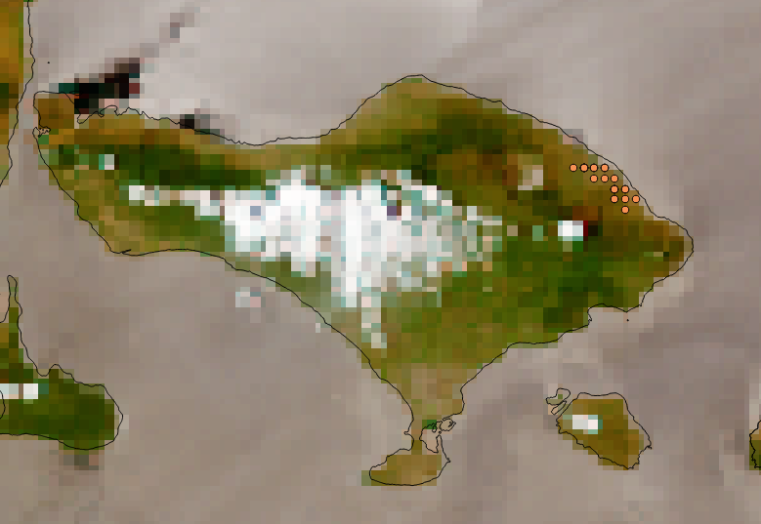
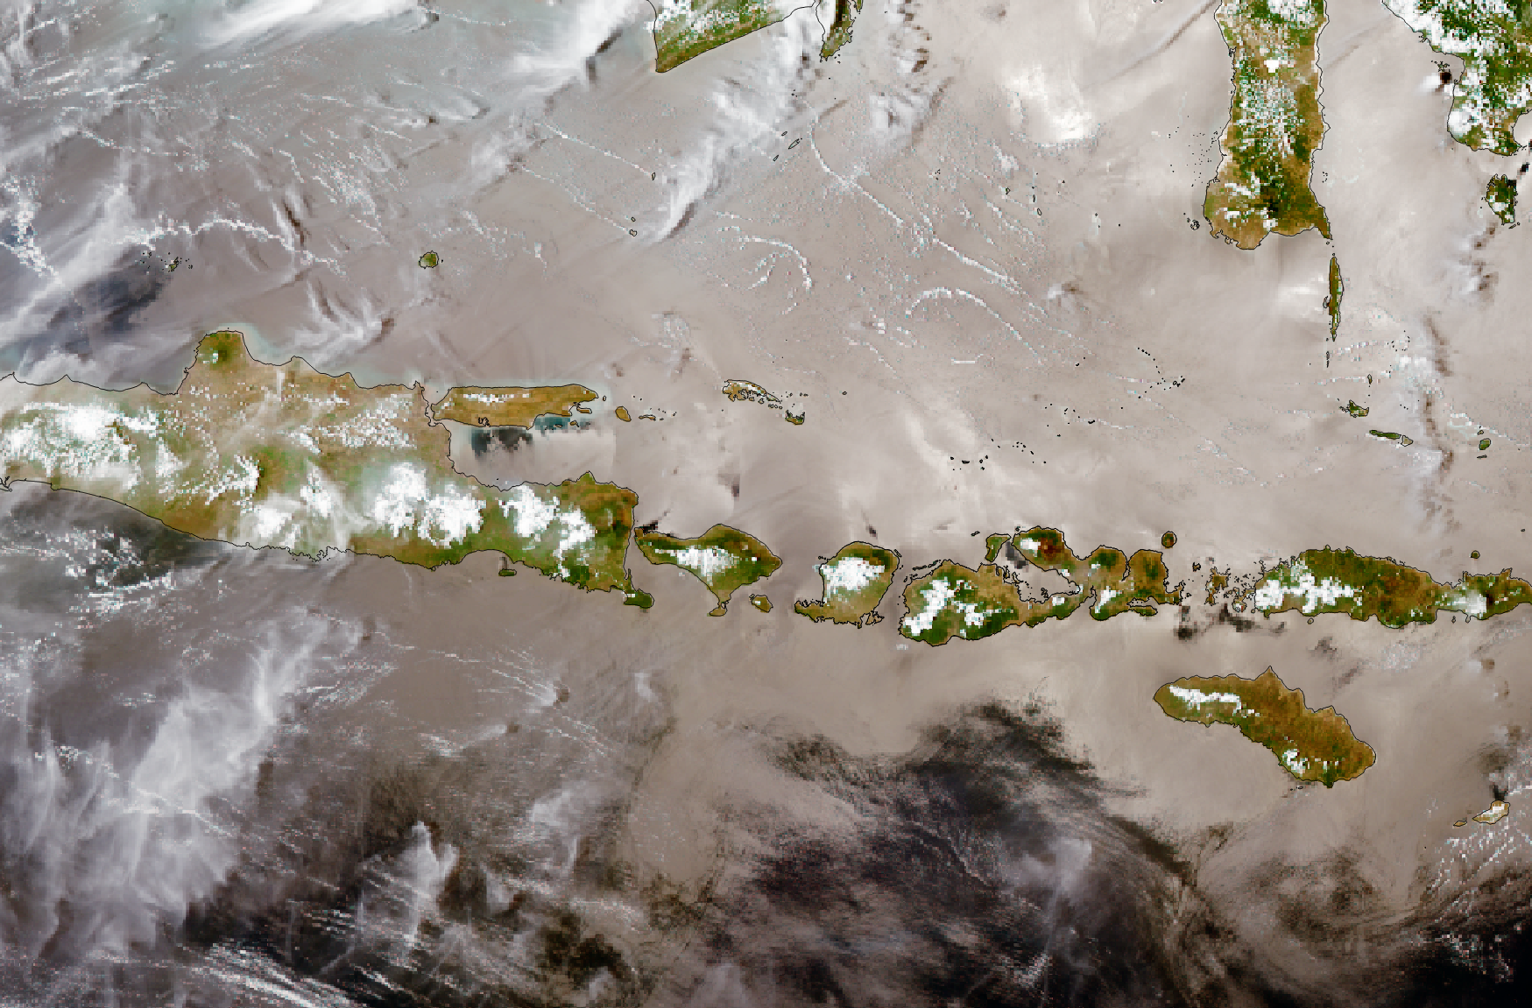
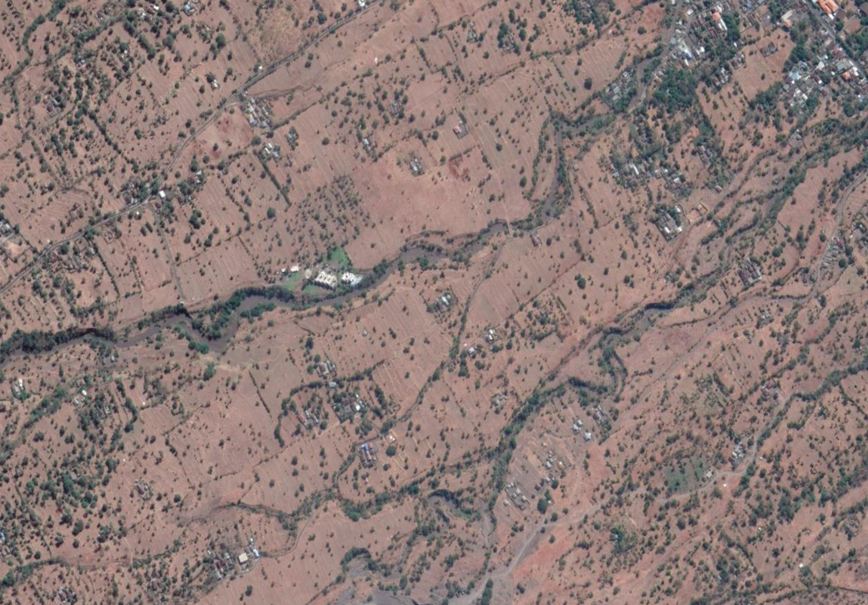
False Alarms due to Sun Glint
Sun glint
Sun glint
False alarm
Bali
Most common false alarms in the tropics
Sun glint induced hotspots
Conventional fire hotspot product not necessarily tuned for Southeast Asia region
Customised filter applied by ASMC to minimise false detections due to sun glint
Reflective surface due to bare grounds in Kubu, Bali

Slide 16
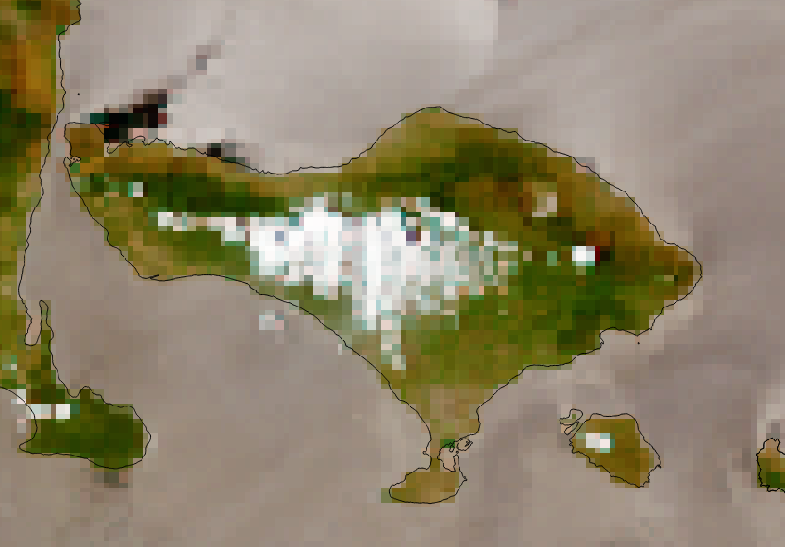
Removal of False Alarms due to Sun Glint
Before
After

Slide 17
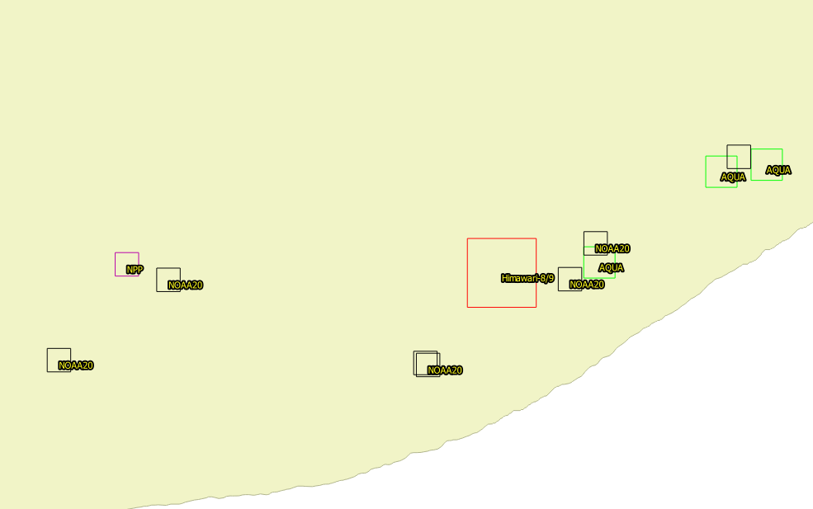

Regridding
Hotspots from different sensors
Different satellite hotspot data has different resolutions or grid size (0.75 - 2 km)
Harmonisation to standardise grid resolution
Appropriate choice of grid size helps user to interpret the inherent spatial uncertainty of hotspot data
All data is gridded to 2 km resolution
Regridded

Slide 18

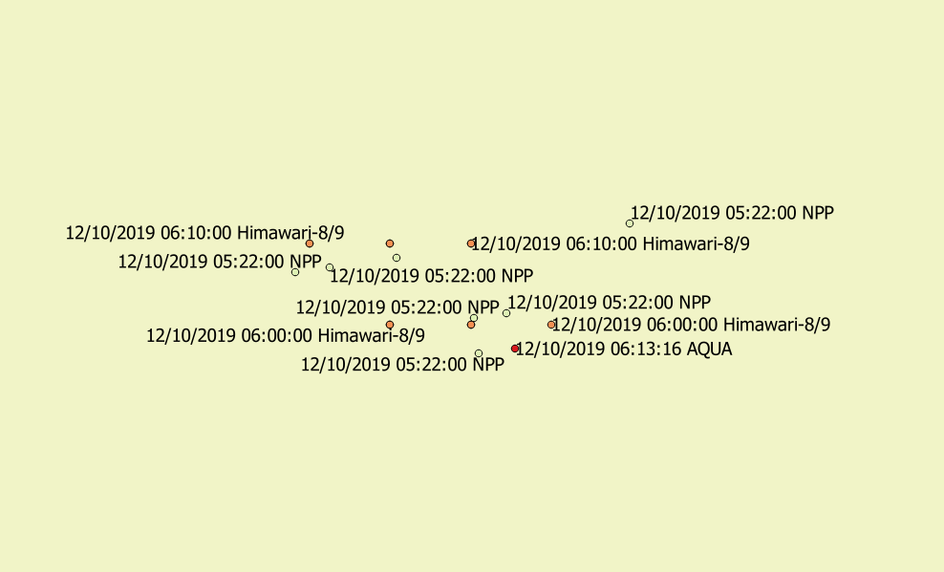
Temporal Aggregation
11.30 am
1 pm
2 pm
2.30 pm
TERRA
AQUA
NOAA-20
Suomi-NPP
Himawari-8
Himawari-8
Himawari-8
8 am
12.50 pm
3 pm
Aggregate fire hotspot detected within a certain observation window period
Observation window period and product update frequency can be adjusted for different users accordingly
Aggregated Hotspots (00 – 09 UTC)

Slide 19
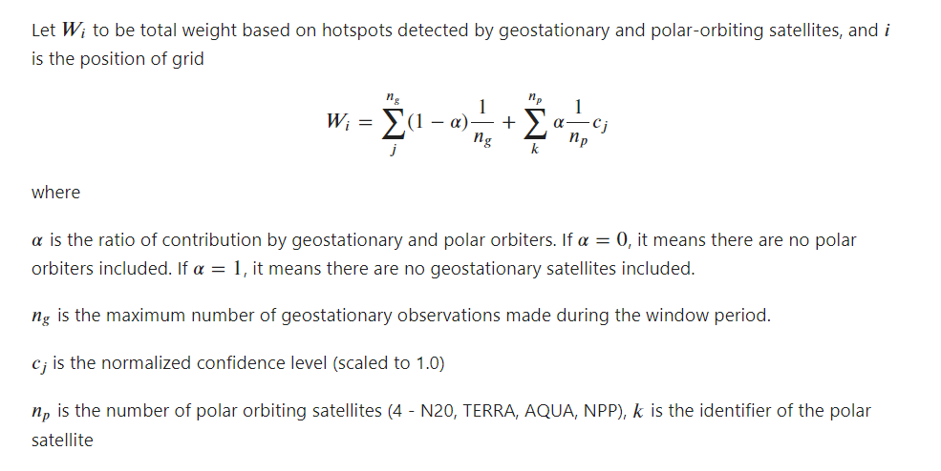

Slide 20
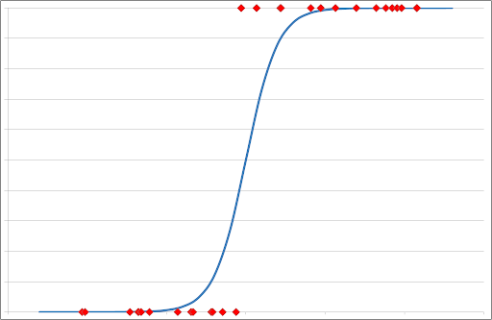
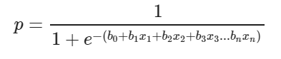
Logistics Regression
Probability
Real fire
1.0
False detection
0.0
1.0
Hotspot weight W_{i}
Probabilistic version of linear regression y = mx + c
In this case, x = hotspot weight W_{i} (earlier slide)
Simple 1-d model
Source: towardsdatascience.com

Slide 21
Sample Product
Fire
Fire
Fire
Fire
Multi-satellite hotspot derived fire grids with probabilistic estimates

Slide 22
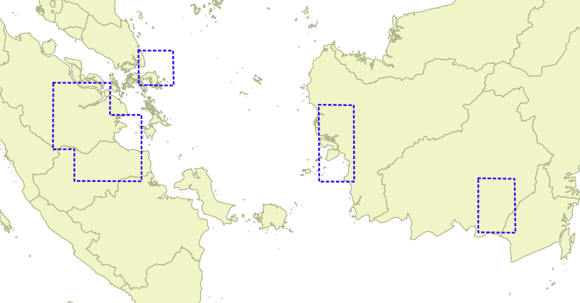
Product Tuning & Verification
Manual tagging of fire areas using very high-resolution satellites (e.g Sentinel-2)
About 1 month of training data covering Sumatra and Kalimantan in 2019
Preliminary result shows at least 10% improvement as compared to using only polar-orbiting satellite hotspot data

Slide 23
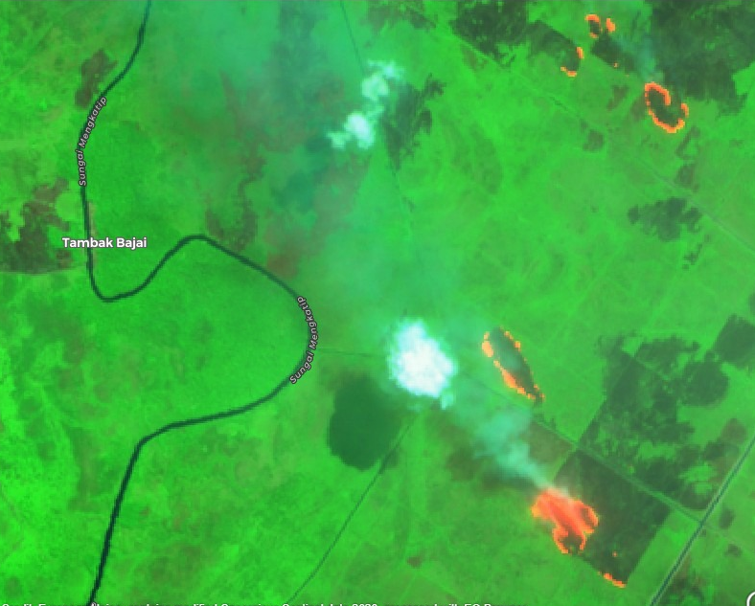
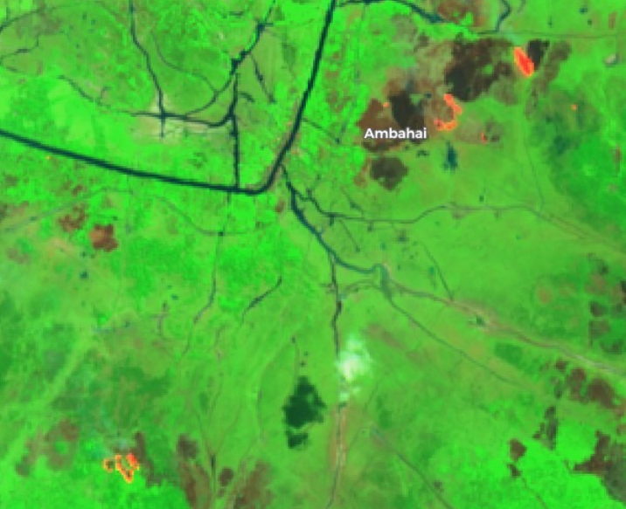
Examples of Label Tagging
Fire areas
Fire areas
Fire areas
Fire areas
Trained remote sensing experts carries out detailed analysis before confirming presence of fires on high-resolution satellite imageries
Labelled data is later reprojected onto the same 2km grid as the multi-sat grid product

Slide 24
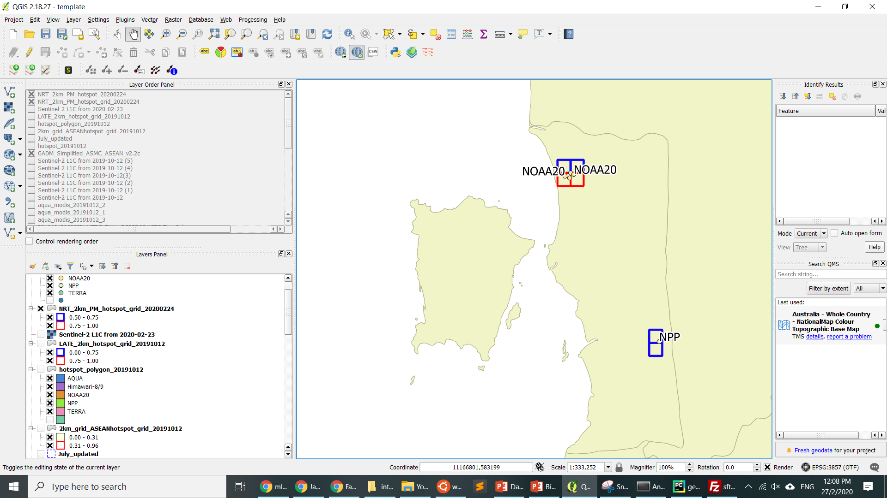
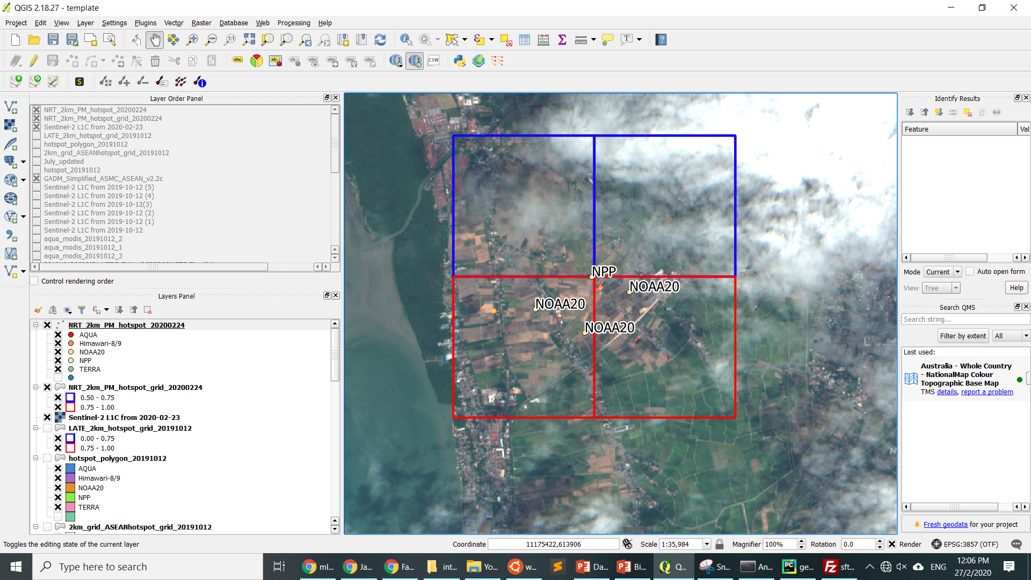
23 – 24 Feb 2020
Multiple hotspots detected by NOAA-20 and Suomi-NPP in Seberang Perai, Penang
High-resolution Sentinel-2 image reveals presence of small fires in paddy fields
Sentinel-2 Fire/True Colour RGB 23 Feb 2020

Slide 25
23 – 24 Feb 2020
ASMC Multi-Sat Fire Detection product managed to accurately identify the fire locations
All observed fires were found to be within the high probability fire grids
Fire
Fire
Fire
Low probability fire grids
Sentinel-2 Fire/True Colour RGB 23 Feb 2020
High probability fire grids

Slide 26
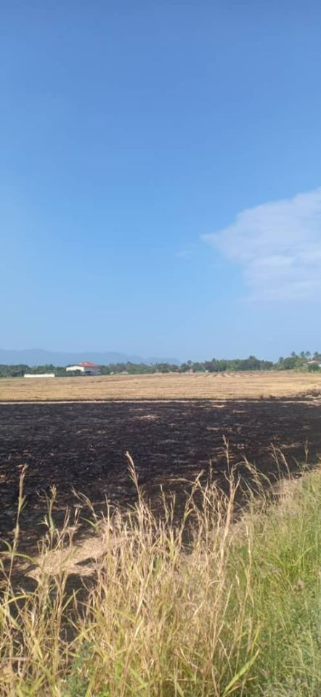
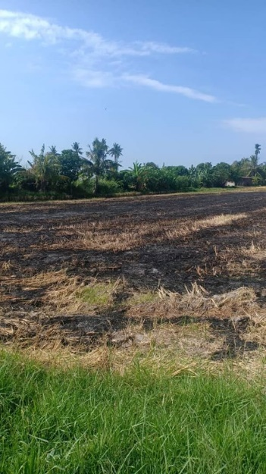
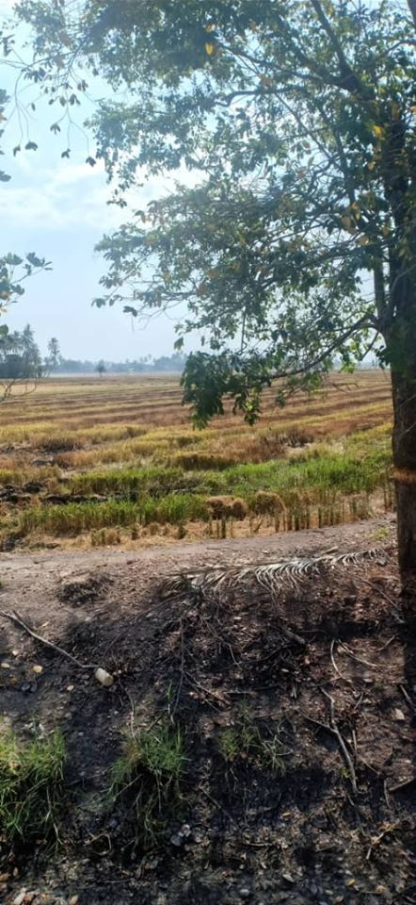
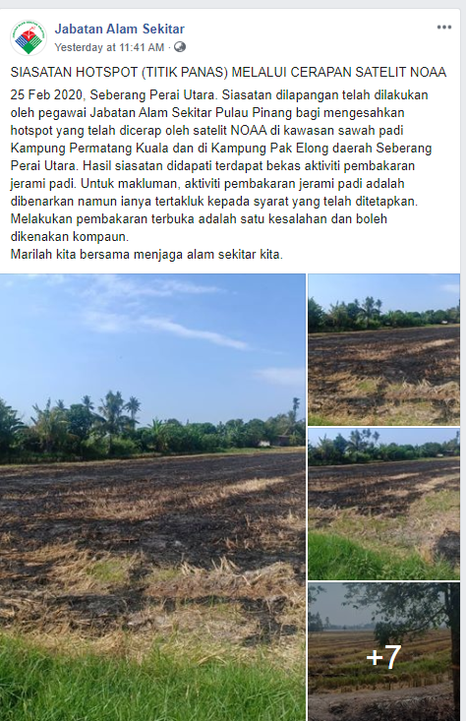
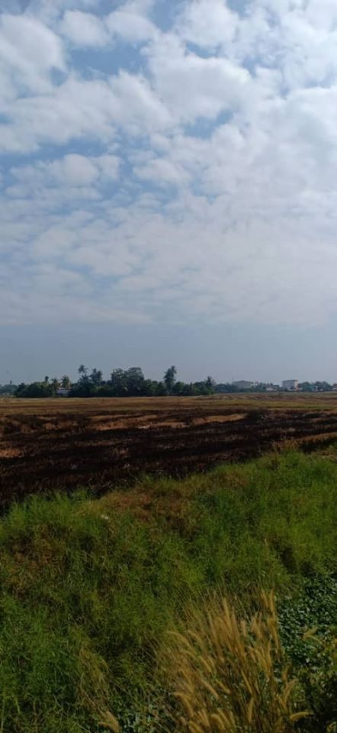
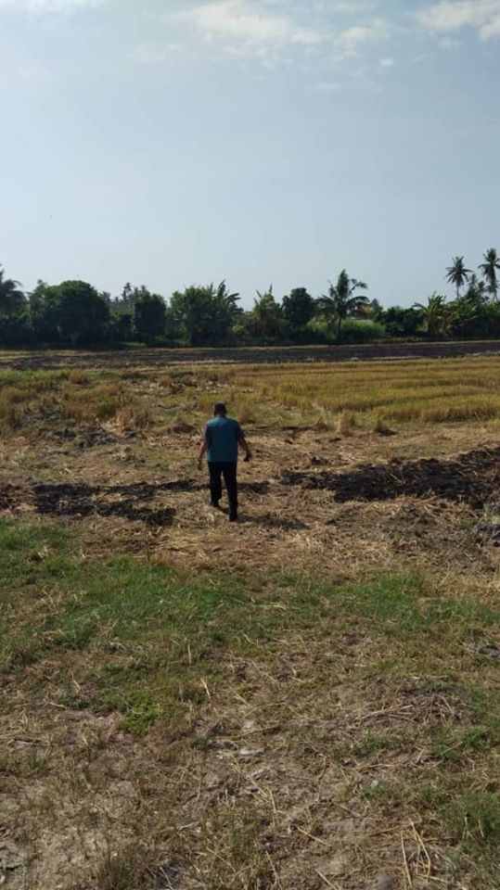
23 – 24 Feb 2020
Fire hotspots were verified by JAS ground staff on 25 Feb
Valuable ground truth info !
Source: Jabatan Alam Sekitar FB page

Slide 27
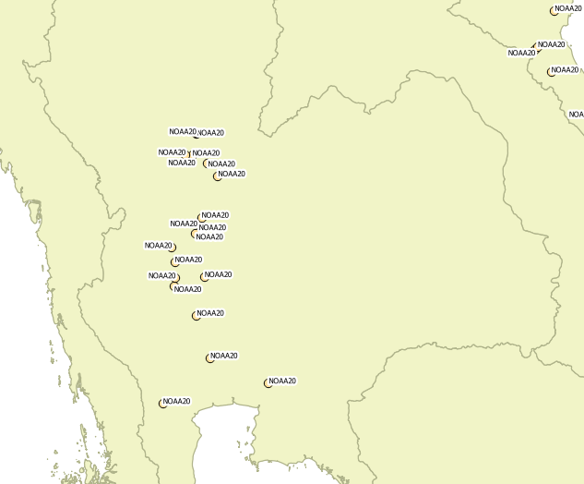
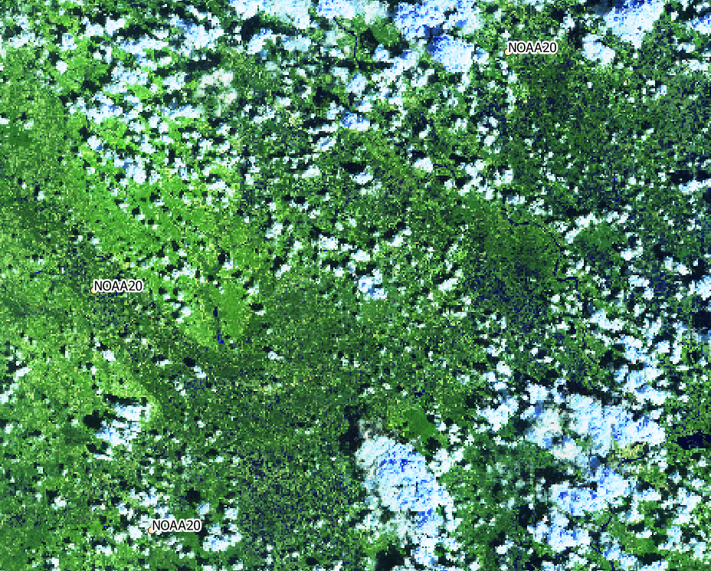
12 Oct 2019
Thailand
Hotspots detected by NOAA-20
Sentinel-2 SWIR RGB 12 Oct 2019
Clusters of hotspots detected by NOAA-20 satellite during rainy season in central Thailand
Found to be false detection based on high-resolution Sentinel-2 image

Slide 28
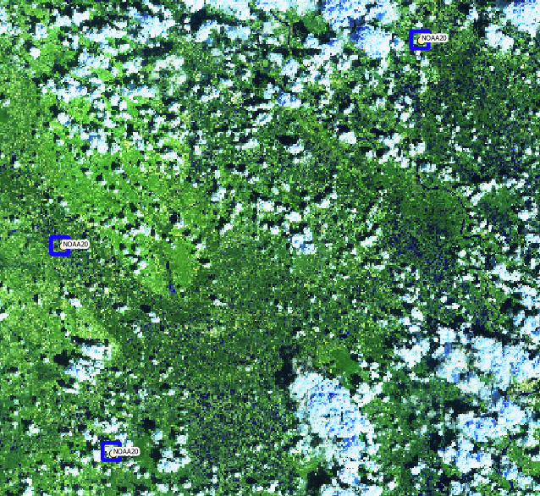
12 Oct 2019
Low probability fire grids
Multi-sat fire detection product flagged these areas as low probability fire grids
Enable users to better optimize limited resources for ground ops

Slide 29
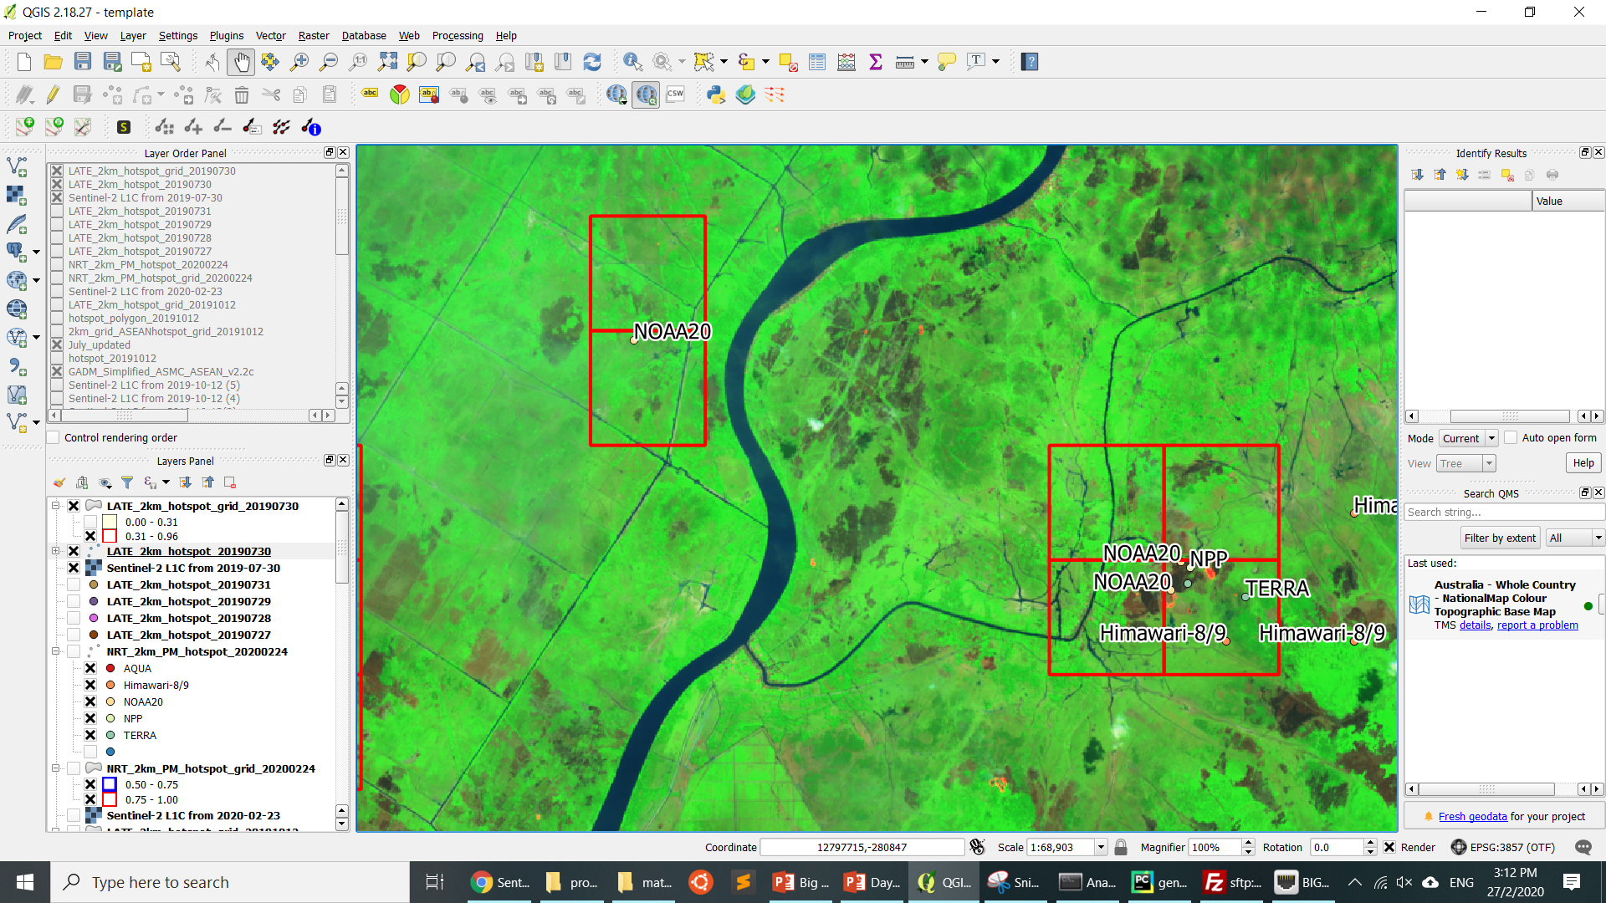
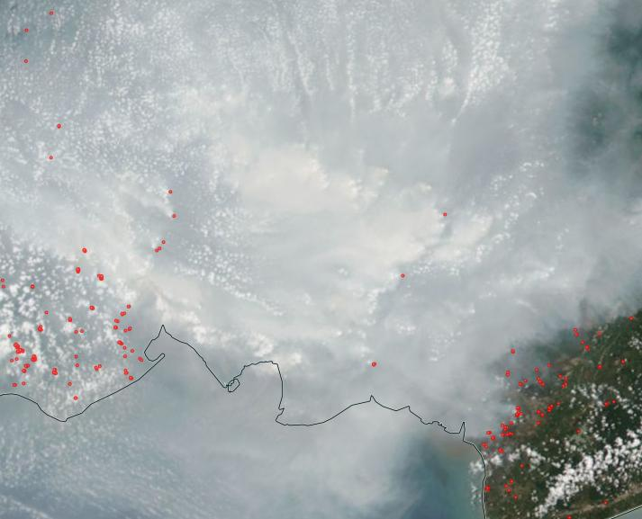
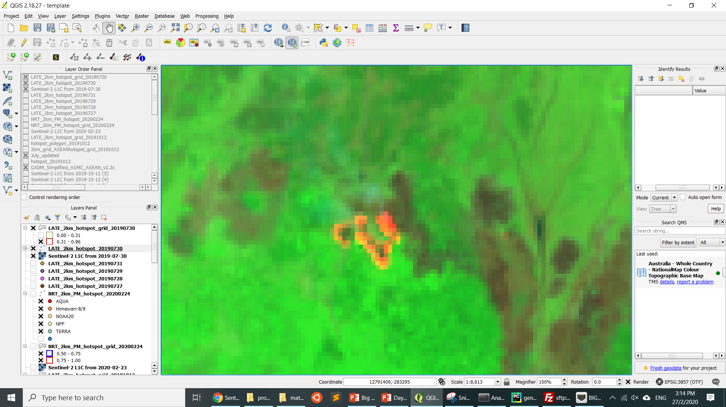
Limitations
Hotspots obscured by dense haze
Small fire not detected by any of the satellites
Model training and verification data based on high-resolution satellite imagery
Subject to issues such as limited temporal and spatial coverage, cloud cover
Not optimal, ground reports are preferred
Small fires, underground peat fires, and fires beneath dense haze/forest canopy may not be detected

Slide 30
Future Plans
Future Plans
Improve product resolution
More robust verification & tuning
Collect trial feedback from users
Use ground reports for evaluation
Collect more ground-truth data for model tuning
Run more ML models
Neural networks, support vector machine …
Include more hotspot data
Fengyun-4A and GK-2A

Slide 31
Case Studies
The following activities are planned:
For users to try out the new hotspot composite product
To learn about the advantages of the hotspot composite product
Identify areas of persistent and large fires via the two methods:
To manually analyse fire hotspot data along with satellite imageries using GIS software
To use the new hotspot composite product
Identify potential false alarms by using hotspot composite product
Identify key limitations of the products
TO BE FINALIZED AFTER CASE STUDIES MATERIALS ARE PREPARED

Slide 32
Discussion with Users
What do you make use of ASMC’s hotspot data ?
What are the ground responses at the national/state/provincial level?
Do you archive ground verification reports ?
What are the follow-up actions if hotspot is verified to be real fire ?
If possible, please share the following info with us:
Common false detections
Reports of missed detections
Feedback for NOAA-20 hotspot data
TO BE FINALIZED AFTER CASE STUDIES MATERIALS ARE PREPARED

Slide 33
